Slide 1
DAY 2 · HUMAN-CENTERED DESIGN
Designed Around You
Yesterday was about the work. Today is about your hands.
Notes:
Welcome them back. Set the tone immediately and physically: yesterday they sat and listened; today they will stand up, draw, and argue. Tell them the day is built around their hands, not yours.

Slide 2
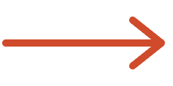
THE BRIDGE
Yesterday: why it takes so long. Today: how we make sure it's the right thing.
Building the right thing is expensive. Building the wrong thing is catastrophic — and you are how we tell them apart.
DAY 1
Notes:
Fast callback so the two days feel like one argument. Yesterday you showed them the hidden work: the iceberg, the questions nobody asks, the data, the security, the policy. Then land the turn that makes today matter: if building the right thing is expensive, building the WRONG thing is catastrophic. Yesterday's closing line was that the most expensive thing you can build is the wrong thing quickly. Today is the discipline that stops that. Say plainly that they are the ones who can prevent it, because they know the work.

Slide 3
You wrote these. We just organized them.
your words, not ours
How might we help someone trust a number without checking it three separate ways?
How might we let people find what they need without knowing which system it lives in?
"I don't trust the report, so I rebuild it by hand every Monday."
"I open four tools before I can answer one question."
How might we make the routine request take a minute instead of an afternoon?
How might we tell someone what changed without making them go looking for it?
"The form is ten screens for something I do every day."
"Something moved and nobody told me until it broke."
Notes:
Walk each statement out loud, slowly, reading one real quote under each. This is the single most important trust-building moment of the day — do not rush it, do not paraphrase their words into corporate language. Say two things explicitly. First: these came from their cards, and every card is in the pile even if it isn't on the wall. Second, ask directly: did we get these right, and is anything big missing? Take two or three corrections live and write them up. If they see you change a statement because of what they said, you own the room for the rest of the day. FACILITATOR: table facilitators post the matching How Might We poster on their table during this slide.

Slide 4
BLOCK 1
Technology designed around humans
Most bad tools aren't badly made. They're made for someone who doesn't exist.
Notes:
One line of setup. Everything built for people carries an assumption about those people, and most bad tools are not badly made. They are made for someone who does not exist.

Slide 5
A STORY · THE SLOW ELEVATOR
The problem wasn't the speed. It was the waiting.
THE ASK
THE REFRAME
"Make the elevator faster."
Put mirrors by the doors.
same elevator!
New motors. New shafts. Expensive. Slow.
Cheap. Fast. Complaints stopped.
Notes:
Tell the classic story. A building gets complaints that the elevators are too slow. The engineering fix is expensive and slow: new motors, new shafts. Someone reframes the problem instead. People don't hate the wait — they hate the EMPTY wait. Mirrors go in. Complaints stop. The elevator was never made faster. The requested solution was 'faster elevators'; the actual job was 'make this wait tolerable.' Build what was requested and you spend a fortune solving it slowly; understand the job and you solve it cheaply. Then the uncomfortable half: engineers can't find that reframe alone, and neither can users alone. It only shows up when both are in the room. That is why they are here.

Slide 6
PART ONE
The ask is a clue, not an instruction.
WHAT WAS ASKED FOR
THE JOB UNDERNEATH
WHAT WE MIGHT BUILD
"Make the elevator faster."
Make the wait tolerable.
Mirrors. Screens. Anything.
your ask here…
Notes:
Generalize the elevator into something they can use. When someone asks for a feature, they've already done a private translation from their problem into a solution — usually based on a tool they've seen. That translation is useful information, but it is not the requirement. Then give permission for the rest of the day: nobody is being accused of asking for the wrong thing. The ask is genuinely valuable; it just isn't the whole story, and the job underneath is where the good options live. FACILITATOR: optional 3-min table turn — each table fills one blank row with something they asked for recently and the job underneath. Take two out loud.

Slide 7
Desirable
SO WHAT IS IT
Start with the person. Not the technology. Not the budget.
the job
Desirable — do people want it? (this morning)
Feasible — can we build it? (after lunch)
Viable — can we sustain it? (the backlog)
Feasible
Viable
Notes:
Give the plain definition. Human-centered design means starting with a real understanding of the people who will use the thing, and staying with them the whole way through — not checking in at the end. The three circles show why it isn't just being nice: something can be lovable and unbuildable, or buildable and unwanted. The job is the overlap. Point out that today maps onto exactly these three circles: the morning is desirable, after lunch is feasible, and the backlog session is viable.

Slide 8
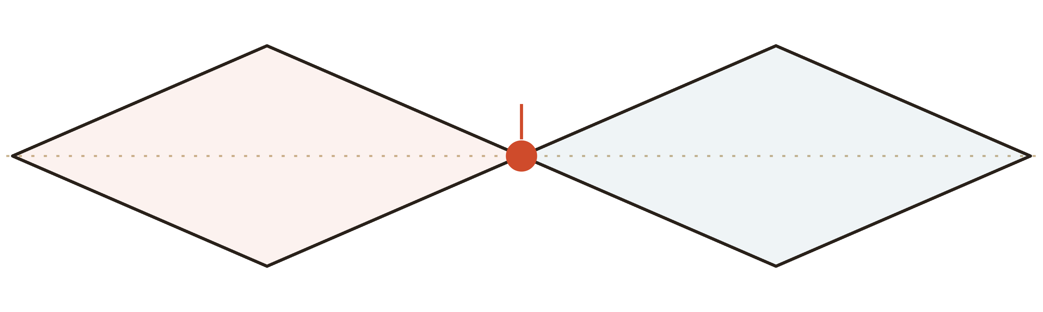
THE MAP
you can't pick a good idea you never had
Go wide. Then narrow. Twice.
PROBLEM
SOLUTION
you are here — yesterday closed Discover
Discover
Define
Develop
Deliver
gather everything
the problem worth solving
many possible answers
what gets built
Notes:
This is the one process model they should leave with, so teach it properly. Diamond one is about the PROBLEM. Discover = going wide: gathering everything, all the friction, no filtering — exactly what their index cards did yesterday. Define = narrowing to the problem worth solving — the How Might We statements on their tables. Diamond two is about the SOLUTION. Develop = going wide again with many possible answers — the studio they're about to do. Deliver = narrowing to what actually gets built — the afternoon. Name the discipline people find hardest: the widening steps feel like waste. Generating twelve ideas when you'll build one looks inefficient, and the instinct is to skip to the answer. But the quality of the final choice is capped by the quality of the options you generated. You cannot pick a good idea you never had.

Slide 9
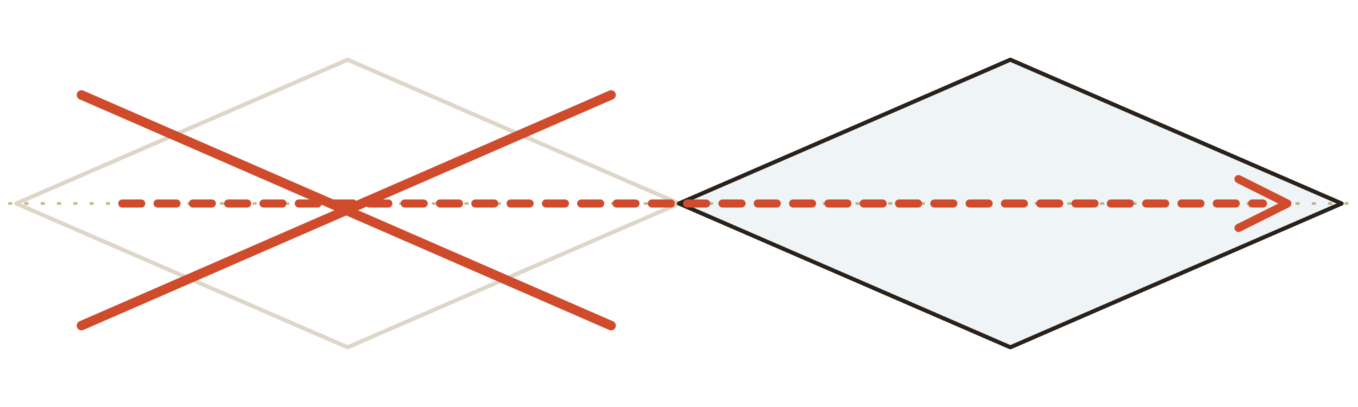
THE SAME MAP
Most failed projects were built exactly as requested.
PROBLEM
SOLUTION
someone's idea
…build it →
Notes:
The common failure is not bad engineering. It's skipping the first diamond entirely: someone has an idea, it goes straight into a plan, and eighteen months later a technically excellent thing arrives that nobody uses. Be candid here, including about your own organization — a little self-criticism buys enormous credibility with a skeptical room. Then connect it to yesterday: this is what 'the wrong thing quickly' actually looks like in practice.

Slide 10
WHAT CHANGES FOR YOU
You are not a stakeholder we check in with. You are part of the process.
You'll be asked about jobs , not features.
You'll see rough things early — rough on purpose.
You'll react to something wrong , not describe something right.
You'll hear "why" a lot. That's not doubt.
Notes:
This is the 'what's in it for me' slide — make it concrete. Tell them what changes: they'll be asked about jobs, not features. They'll see rough things early — rough on purpose, because polished work is hard to criticize honestly. They'll be asked to react to something wrong rather than describe something right, since people are far better at critique than specification. And they should expect to be asked 'why' more than they're used to — that's not doubt, it's the first diamond.

Slide 11
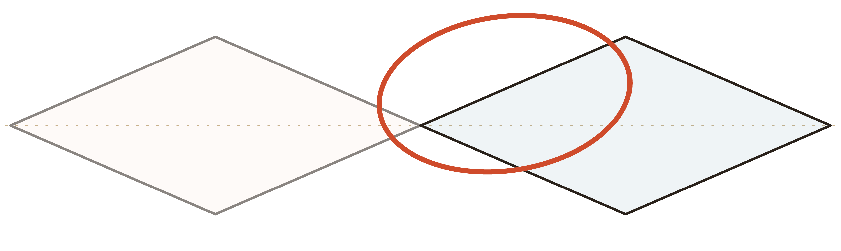
AFTER THE BREAK
yes, there will be drawing
You're here.
PROBLEM
SOLUTION
Discover
Define
Develop ←
Deliver
Notes:
Point at the diamond and tell them exactly where they're going. The problems are defined and on their tables. After the break, they widen. Set expectations for the anxiety about to arrive: they'll be asked to draw, most of them will hate the idea, and it will be fine. Send them to break on that note rather than explaining the exercise now — explaining the studio before a break wastes the explanation.

Slide 12




BLOCK 2 · THE STUDIO
No drawing skill required. Boxes and stick figures win.
No skill required
Fast beats good
Quantity first
No critique yet
Notes:
Lower the barrier hard and fast — half the room is quietly panicking about being asked to draw. Say it directly: nobody is judging the art, and the ugliest sketch in the room has won plenty of these before. Give the four rules. Quantity before quality (you can't pick a good idea you never had). Fast beats polished. Words on a sketch are allowed and encouraged. And no critique during generation — not even of your own idea — since the fastest way to kill a room's ideas is to evaluate them while they're still arriving.

Slide 13


4 minutes
Deliverable → 8 boxes, 8 ideas
8 boxes. 4 minutes. Go.
"A better way to wait in line."
1
2
3
4
Notes:
Run a throwaway warm-up on a neutral prompt so the first sketch of the day carries no stakes. Eight boxes, four minutes, one idea per box, silent. Push them when they stall around box four (everyone does) — the interesting ideas live after the obvious ones run out. When time's up, don't share. Just ask for a show of hands: who filled all eight, who surprised themselves. Then say the honest thing: boxes six through eight were the strange ones, and the strange ones are the point. FACILITATOR: table facilitators sketch too. Visibly. Badly.

Slide 14
4 minutes
Deliverable → everyone knows their prompt
Your table. Your problem. Your turn.
YOUR HOW MIGHT WE
How might we help someone trust a number without checking it three separate ways?
Design for the person in the quote — not the whole organization.
Notes:
Assign each table its How Might We statement — already on their poster. Tell them the one constraint that matters: design for the person in the quote, not for the whole organization. Specific beats universal every time — a solution that perfectly serves one real person usually serves many, while a solution designed for everyone serves nobody. Remind them they're still in the wide part of the diamond, so nobody should be converging yet.

Slide 15

12 minutes
Deliverable → as many ideas as you can
SILENT
Individual. Words on your sketches are welcome. No talking — facilitators included.
Notes:
Explain why silent, because people find it strange: talking first means the loudest and most senior voice anchors the whole table, and you lose every idea that disagreed. Silence protects the quiet people — and the quiet people are frequently the ones doing the actual work being discussed. Everyone sketches alone. Words allowed. No talking, including facilitators. FACILITATOR: enforce silence gently but firmly. Warn at 6 minutes and at 2. Watch for anyone frozen and put a marker in their hand with a whisper of 'just draw the annoying part.'

Slide 16
15 minutes
Deliverable → dots on the strongest ideas
60 seconds each. Then vote with dots.
Stealing is encouraged.
No defending, no apologizing. Clarifying questions only. Three dots each — your own ideas count.
Notes:
Each person gets 60 seconds to walk their table through their sketches — no defending, no apologizing (people will try constantly). Others may ask clarifying questions only, not 'have you considered.' Then each person places three dots on the ideas or fragments — anywhere on the table — that feel strongest, including their own. Say clearly: combining ideas is the goal, not choosing a winner, and the best concept usually turns out to be a mash-up of three people's fragments. FACILITATOR: keep 60 seconds per person hard. A quiet timer at each table beats the host calling time.

Slide 17
25 minutes
Deliverable → one filled concept poster
Name it
One-Look Numbers
One concept per table. Fill the poster.
Who it's for
…
The job it does
…
How it works, in 3 steps
…
The name matters more than you think.
What changes for them
← stress this one
Notes:
Now they converge for the first time. Each table builds one concept, drawing from the dotted ideas, and fills the poster: name it, who it's for, the job it does, how it works in three steps, and what changes for that person. Stress the last line hardest — 'what changes for that person' is what makes it a design instead of a feature list, and it's the line the afternoon will lean on. Tell them the name matters more than they think: a concept with a name survives a meeting, and a concept without one does not. FACILITATOR: at 15 minutes remaining, warn tables still arguing about scope to pick one thing and go deep. Photograph all individual sketches now while tables work.

Slide 18
3 minutes / table
Deliverable → every concept on the wall
3 minutes per table. Then we look for patterns.
One question per concept. No critique yet. Watch for two tables landing in the same place.
Notes:
Each table posts their concept on the wall and presents for three minutes. Hold the time strictly and visibly so later tables get the same airtime as the first. Do NOT open the floor to critique after each one. Ask the room for one question per concept — questions only — and hold everything else. After all tables have gone, spend the last 5 minutes on patterns rather than judgment: which concepts serve the same underlying job, where two tables independently landed in the same place, which How Might We statements produced the most energy. Independent convergence is a strong signal — name it out loud when it happens. Close by telling them what happens over lunch: engineering leads will study these posters and come back with honest answers, not polite ones. FACILITATOR: scribe captures every concept name and its one-line job into a running list. Leads get that list plus photos at the start of lunch.

Slide 19

BLOCK 3 · LUNCH BEHIND US
From concept to reality check
Nothing here is a verdict. You know the job. Engineering knows the terrain. Neither knows the whole map alone.
Notes:
Frame this session very deliberately — the room is bracing to have their morning's work marked. Say plainly that nothing here is a verdict, and no idea is being killed in this session. The goal is shared understanding: they know the job, engineering knows the terrain, and neither knows the whole map alone. Remind them of yesterday's material — this is where the iceberg, the data, the security, and the policy come back and land on their own ideas. That's the moment the two days click together.

Slide 20
WHAT ENGINEERING ANSWERS
1
2
3
Could we build it?
What would it take?
What would we need to figure out first?
Should we build it?
— that one's yours. You'll answer it next.
Notes:
Introduce the three questions and be explicit about the one that's missing. Engineering answers these three, and the room will notice 'should we build it?' is not on the list. Tell them why: that question is theirs, not engineering's, and they'll answer it themselves in the next session. Engineering's job is to tell them what a thing costs and what's unknown. Deciding what's worth it belongs to the people who know the mission. Saying this out loud transfers ownership and changes how the whole afternoon feels.

Slide 21
"Hard" usually means "uncertain," not "impossible."
not a traffic light
Well-trodden path
Some unknowns
Genuine unknowns
Done this shape of thing before. We can estimate it with confidence.
Buildable, but open questions change the size. The estimate is a range.
Real investigation needed before anyone can honestly estimate.
Notes:
Give them shared vocabulary before feedback starts, or every comment will be heard as yes or no. Well-trodden means the team has done this shape of thing before and can estimate with confidence. Some unknowns means it's buildable but there are open questions that change the size. Genuine unknowns means real investigation is needed before anyone can honestly estimate. Make the reframe explicit: when an engineer says something is hard, they usually don't mean impossible — they mean uncertain, and uncertainty is what makes estimates wide. That connects straight back to yesterday's 'ask for ranges, not dates.'

Slide 22
~6–7 min / concept
1 Could we?
·
2 What would it take?
·
3 What to figure out first?
CONCEPT ON THE FLOOR
[ Concept name ]
Say what's easy first. Then name which force makes the rest hard.
Notes:
Work through each concept in turn — with six tables, roughly 6 to 7 minutes each, so hold the clock. For each: the table gives a 30-second reminder of the job it does. An engineering lead answers the three questions honestly, using the vocabulary from the previous slide. Then two minutes of open exchange, where the most valuable move is engineering asking 'what if we solved it this way instead?' and the table saying whether that would still do the job. Some of the best outcomes of the day come from exactly that trade. Coach the leads beforehand on two habits: always say what IS easy before what is hard (starting with the obstacle reads as a no); and when something is genuinely difficult, explain which of yesterday's forces is causing it — data, security, policy, or a dependency — since the room now has the vocabulary to understand the answer. FACILITATOR: scribe fills a card per concept in real time — difficulty band, the single biggest unknown, and any alternative approach suggested. These cards drive the next session; finish before the break.

Slide 23
Nothing was killed. Everything got clearer.
so — which ones are worth it?
One-Look Numbers
Well-trodden path
Find-It-Once search
Some unknowns
One-Minute Request
Some unknowns
Tell-Me-What-Changed alerts
Genuine unknowns
The hardest parts clustered around data quality and permissions — not the visible feature.
Notes:
Summarize the shape of what emerged, not each individual answer. Usually a few patterns are worth naming: several concepts share one underlying dependency, or the hardest parts cluster around data quality or permissions rather than the visible feature. Say clearly that no idea was eliminated, and that the room now knows something it did not know this morning — what each idea would actually cost. Send them to break with the next question already planted: now that you know the price of each, which ones are worth it?

Slide 24

BLOCK 4
What gets built first, and why
Everything on the wall could be built. Not all at once. Sequence is the real decision — and it's yours.
Notes:
Open by handing them the question you withheld earlier. Engineering answered 'could we' and 'what would it take.' Now the room answers 'should we' — and they own it. Be honest about the constraint that makes the session necessary: everything on that wall could be built, and not everything can be built at once, so sequence is the real decision.

Slide 25
HOW WE'LL DECIDE
You own the vertical. Engineering owns the horizontal.
Plan carefully
Do now
Changes your work →
Neither side can fill in the other's axis. That's why you're both in the room.
Not now
Easy wins
What it would take →
Notes:
Explain the grid and, more importantly, who owns which axis. The vertical axis is impact on their actual work — only they can place that. The horizontal is effort and uncertainty — engineering already placed it during the reality check. Neither side can fill in the other's axis, which is the whole reason both are in the room. Walk the quadrants briefly. High impact + light effort = easy wins, soon. High impact + heavy effort = need real planning, not optimism. Low impact + light effort = pleasant, but don't let them crowd out the first two. Low impact + heavy effort = not now. Be precise about 'not now': it means not in this cycle, reasons recorded, and it can change. It doesn't mean the idea was bad or that it disappears.

Slide 26
WHEN THE GRID ISN'T ENOUGH
a tiebreaker, not a verdict
Put a number on "worth it": BRICE.
B
R
I
C
E
Business importance
Reach
Impact
Confidence
Effort
Does it serve the mission? 1–3
How many people it touches. #
How much it changes the work. .25–3
The cost from the reality check.
How sure are we? %
You own B · R · I . Engineering owns E. Confidence is today's shared honesty.
Score = (B × R × I × C) ÷ Effort
BRICE — a business-weighted take on RICE. Credit: Kasey Kaplan.
Notes:
The 2x2 sorts by feel. BRICE lets you put an actual number on the same instinct — useful when two concepts land in the same square and you need a tiebreaker. Walk the five letters. Business importance: does it serve the mission (1 to 3). Reach: how many people it touches. Impact: how much it changes their work — the vertical axis again. Confidence: how sure we are, as a percentage, straight from the reality check. Effort: the cost engineering placed on the horizontal. Multiply the first four, divide by effort; higher scores rise to the top. Say who owns what: the room owns Business, Reach, and Impact; engineering owns Effort; Confidence is the shared honesty from today. Then the warning — do not worship the number. It ranks; it does not decide. It is a conversation starter, not a verdict. BRICE is a business-weighted take on RICE (credit: Kasey Kaplan).

Slide 27
The same four concepts, ranked.
the grid said the same thing
Concept
B
R
I
C
E
Score
One-Look Numbers
3
120
2
80%
2
288
One-Minute Request
2
200
2
70%
3
187
Find-It-Once search
2
150
1.5
60%
4
68
Tell-Me-What-Changed
2
80
1
40%
5
13
When the number and the room disagree, that gap is the conversation — not a reason to trust the formula. It ranks; you decide.
Notes:
Show the same four shortlist concepts run through BRICE so they see the method produce a ranking, not a truth. Read one row out loud end to end so the multiplication feels concrete, then point at the order it produced. Make two points. First, the ranking here matches the instinct from the grid — that's reassuring, and when the number and the room disagree, that disagreement is the useful part, worth talking through rather than trusting the formula blindly. Second, the only inputs engineering set were Effort and half of Confidence; everything else came from the room, which is exactly the ownership split from the grid. Close by repeating: it ranks, it doesn't decide — the decision is still theirs.

Slide 28
20 minutes
Deliverable → every card on the grid
Place them. Then argue about it.
The argument is the output. Don't resolve it away — record it.
Notes:
Run this standing up at the wall — sitting kills the energy of the last working session of a two-day summit. Engineering places each concept card horizontally first, using the difficulty bands from the reality check. Then the room places each card vertically by impact. The argument that happens while placing is the actual output, so don't rush past disagreement. When two people place the same card very differently, ask both who they were thinking about — they're usually both right about different people, and that difference is real information. Have the scribe capture the disagreements rather than resolving them away. FACILITATOR: timebox debate on any single card to 2 minutes. If unresolved, place it on the line and move on. Scribe records the split.

Slide 29
The three to five we take forward first.
a list of fifteen isn't a shortlist
One-Look Numbers
One-Minute Request
Find-It-Once search
Job: trust a number at a glance.
Job: routine ask in a minute.
Job: find it without knowing the system.
Unknown: which source is truth.
Unknown: which approvals are required.
Unknown: what we're allowed to index.
Next: confirm access rules with two owners.
Next: map the three current sources.
Next: shadow one real request end to end.
A shared recommendation with evidence — not yet a funded, dated plan.
Notes:
Narrow to a shortlist of three to five — the second diamond closing. Resist a longer list even under pressure, and say why: a prioritized list of fifteen is not prioritized, it's a wish list with numbers on it, and everything on it moves slowly. For each shortlisted item, state three things aloud so the room hears the commitment take shape: the job it serves, the biggest unknown from the reality check, and what the immediate next step is. Then be straight about what this is and isn't. It IS a shared recommendation with real evidence behind it. It is NOT yet a funded, dated plan — pretending otherwise would break the trust built over two days.

Slide 30
THE OPPORTUNITY BACKLOG
Nothing gets thrown away.
Shortlisted
taken forward
Held with reasons
backlog
Not now
backlog
Every concept is captured with its difficulty band, its unknowns, and today's reasoning. When circumstances change, the work already exists.
Revisit when a dependency lands
backlog
they will check. mean it.
Notes:
This slide protects everyone whose idea didn't make the shortlist — most of the room. Everything on the wall goes into the opportunity backlog with its difficulty band, its unknowns, and the reasoning from today attached. Explain what the record is worth: when circumstances change, when a dependency lands, or when someone asks for something similar next quarter, the work already exists rather than starting over. Say the sentence directly — no idea from today disappears — and mean it, because they will check.

Slide 31
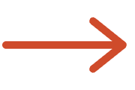
This morning: pain points. Now: a plan with evidence.
THIS MORNING
NOW
"the report is wrong"
Framed problems
"too many tools"
Concepts you made
"the form is endless"
Honest feasibility
An agreed sequence
Every item carries both sides of the story — the job and the cost. That's what usually goes missing.
Notes:
Show them the distance travelled in one day — in the middle of a workshop people lose track of it. They arrived with friction they lived with privately. They now have framed problems, concepts they made themselves, honest feasibility from the people who would build them, and an agreed sequence. Name the thing that makes it different from a normal wish list: every item carries both sides of the story — the job and the cost — which is exactly what usually goes missing.

Slide 32
BLOCK 5 · CLOSING
This month
What happens next
M
T
W
T
F
S
S
1
2
3
4
5
6
7
You've all been to a workshop that produced nothing. This is the part that decides whether this was one.
8
9
10
11
12
13
14
15
16
17
18
19
20
21
Notes:
Tell them this is the part that determines whether the summit mattered. Everyone in the room has been to a workshop that produced nothing, and they're quietly waiting to find out if this was one. Answer that directly.

Slide 33
Every commitment has a name and a date.
a person, not a team
WHAT
WHO
BY WHEN
Write up the day and circulate it
[name]
[date]
Own each shortlisted concept
[name]
[date]
Investigate the feasibility unknowns
[name]
[date]
This group hears back next
[name]
[date]
If the outcome is genuinely uncertain, commit to a date for the decision — not an invented date for the result.
Notes:
Go line by line. Names of people, not team names, and real dates, not 'in the coming weeks.' At minimum cover: who writes up the day and when they'll circulate it, who owns each shortlisted concept, when the feasibility unknowns get investigated, and when this group hears back next. If something is genuinely uncertain, commit to a date for the DECISION rather than inventing a date for the outcome. That distinction is both honest and useful — this audience will respect it more than optimism.

Slide 34


This isn't the last time we ask.
a loop, not a line
1
2
3
Rough concepts, shown early
Feedback sessions
Testing with real users
Who will give us 30 minutes when a rough version exists?
hands up now →
Notes:
Set expectations for the ongoing relationship — one summit is not human-centered design, it's an event. Tell them concretely what to expect: they'll be shown rough work early and asked to react, some of them will be asked to be tested WITH rather than presented TO, and the loop repeats rather than ending at a launch. Ask for something specific in return — a request lands better than a vague invitation. Ask who's willing to be contacted for 30 minutes when a rough version exists, and get hands or names in the room while the energy is still there.

Slide 35
THE CLOSE
We can build almost anything. You're how we know what to build.
Yesterday: the most expensive thing you can build is the wrong thing quickly. Today is the answer to it.
DAY 1
Notes:
Bring the two days together in a short close — keep it short, because a long ending undoes a good day. Day 1 was honest about the cost of building: the hidden work, the data, the security, the policy, the reason a small ask becomes a long project. Day 2 was about making sure that cost buys something worth having. Reflect back one or two specific things the room produced today, by name — specificity is what makes gratitude credible. Then land the closing pair. Yesterday ended on the most expensive thing you can build being the wrong thing quickly. Today ends on its answer: they are the reason it will be the right thing. Thank them by name where you can, and finish clean.

Slide 36
Thank you.
The write-up comes within five working days. The wall stays up — photograph it.
[Owner name] · [email]
[Owner name] · [email]
Notes:
Leave this up while people gather their things. Make sure the concept wall stays up long enough for people to photograph it, and that they know the write-up is coming and when.

